Slide 1
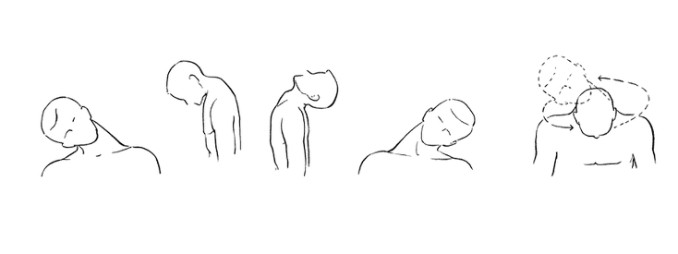
NecX
Enabling Gesture Control Using the Neck
Team 2
CSE 477, Spring 2014
Ke-Yu Chen, Aniket Handa, Chaoyu Yang, Shuowei Li

Slide 2
Why?

Slide 3
Neck contains a lot of information

Slide 4

Drinking

Slide 5
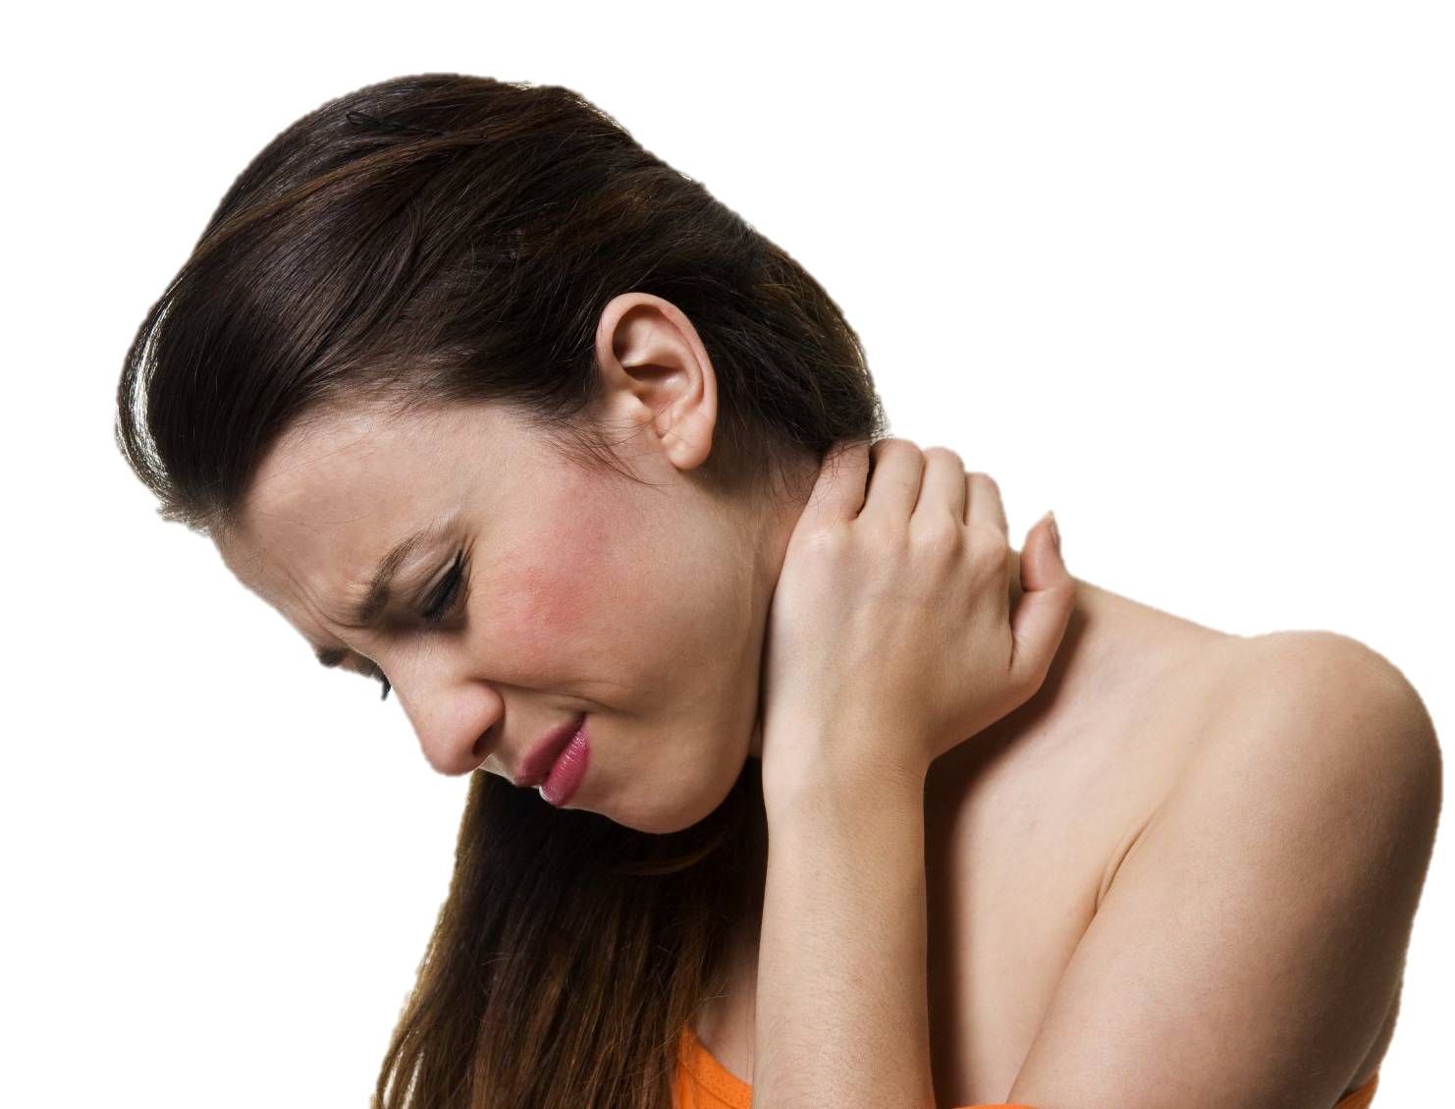
Muscle Stress

Slide 6
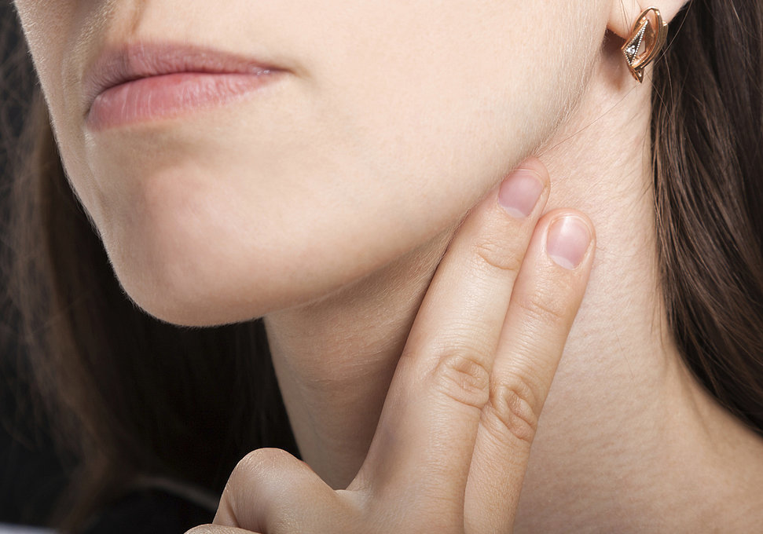
Heart Rate

Slide 7
Neck Gestures

Slide 8
Drinking
Accelerometer
Microphone
Gyroscope
sEMG
Surface Electromyography
Vibration
Heart Rate
Muscle Stress
Neck
Gesture
Neck
Gesture

Slide 9
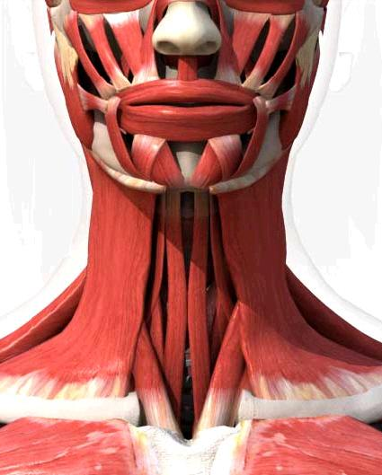
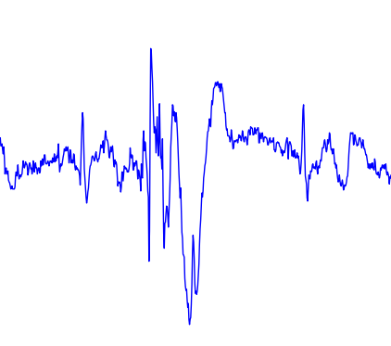
Surface Electromyography (sEMG)
_{Motor Unit}
_{Electrodes}

Slide 10
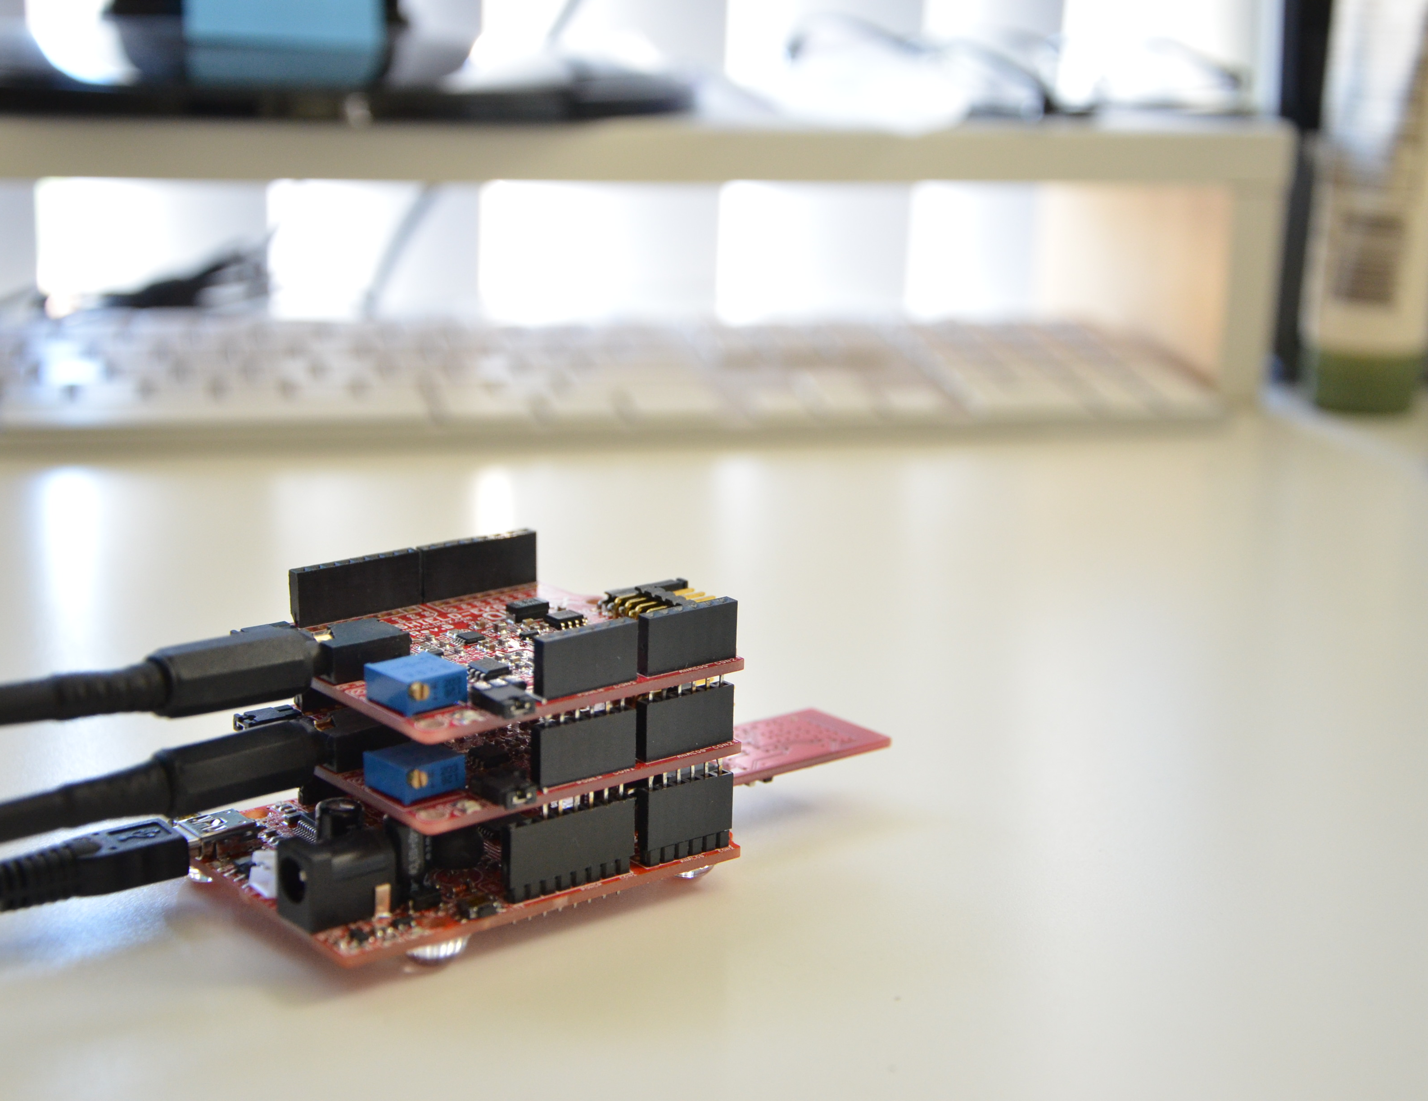
Hardware
Shield board
(up to 6 channels)
Bluetooth
Olimex-328

Slide 11
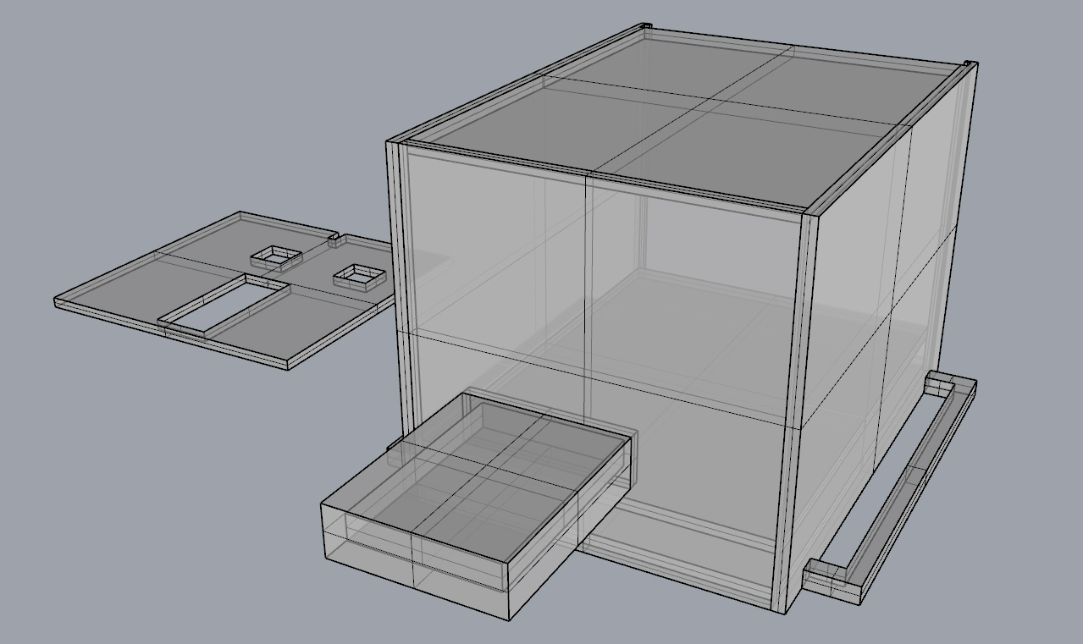
3D Printing

Slide 12
System Flow
(1)
Smooth
and Segmentation
Raw
Data
(2)
Feature
Extraction
(3)
Gesture Recognition

Slide 13
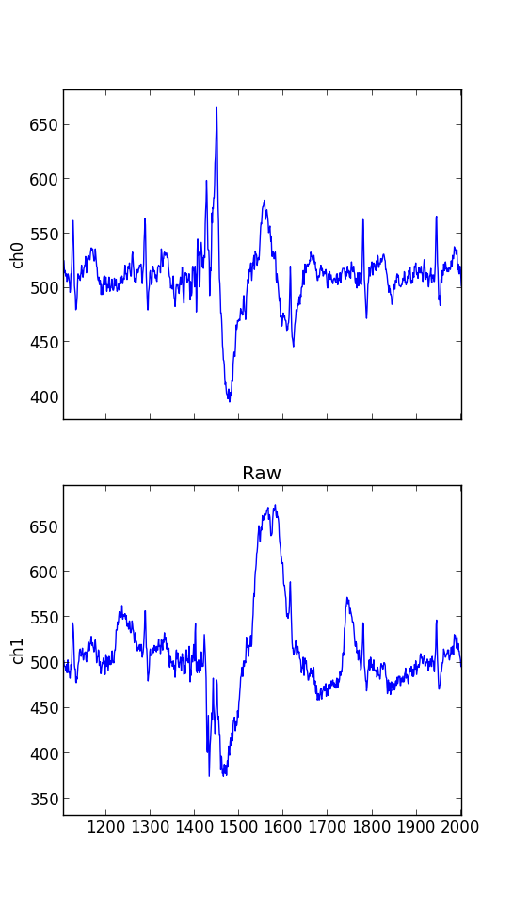
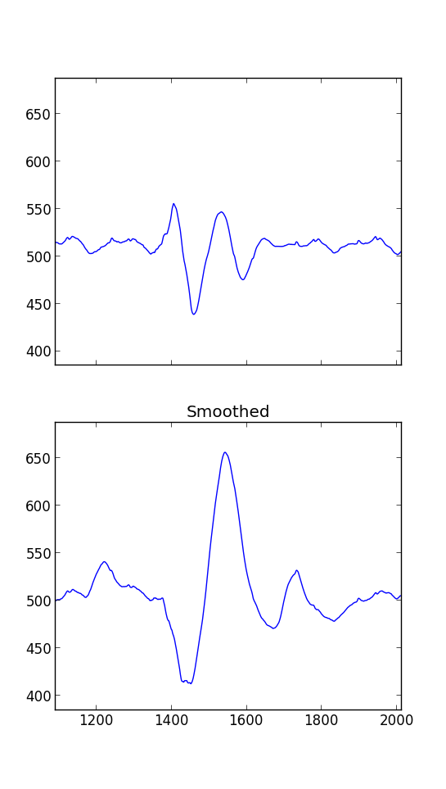
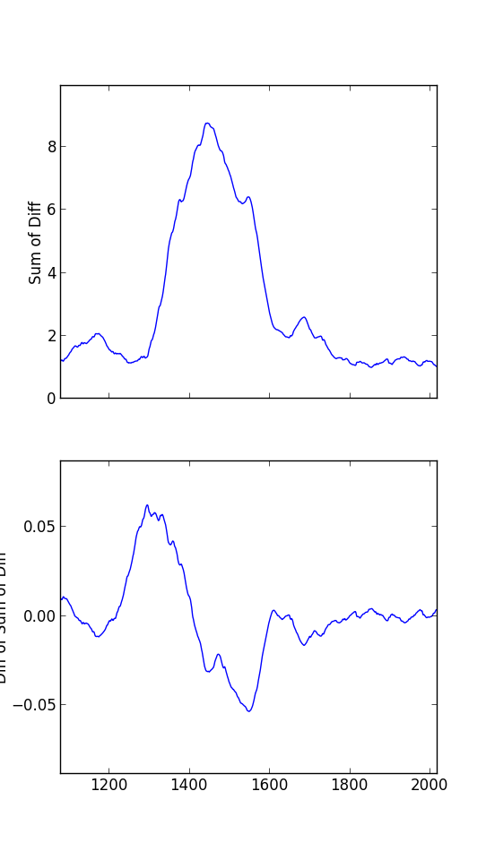
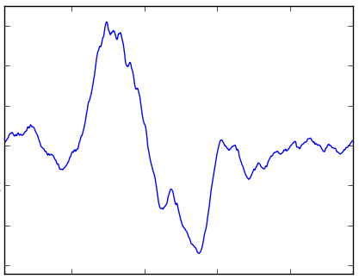
Gesture Detection
_{Raw data}
Smooth
Segmentation
_{Ch1}
_{Ch1}
_{Total Variation}
₁st _{Derivative}
_{Ch2}
_{Ch2}
_{Start}
_{End}

Slide 14
Gesture Detection
_{Raw data}
Smooth
Segmentation
_{Ch1}
_{Ch1}
_{Ch1}
_{Total Variation}
₁st _{Derivative}
_{Ch2}
_{Ch2}
_{Ch2}
_{Start}
_{End}

Slide 15
Gesture Classification
Features
Classification
_{Ch1}
Auto Correlation
_{SVM}
Cross Correlation
_{RFBNetwork}
_{LMT}
Zero Crossing
_{Ch2}
Max Min Difference
…
_{BayesNet}
_{NNge}
(8 features)

Slide 16
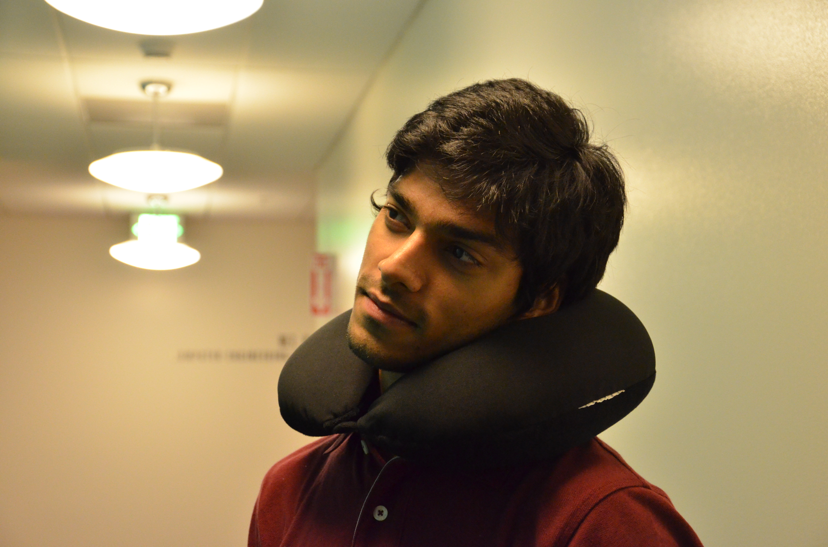
Wearables

Slide 17

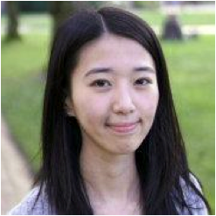
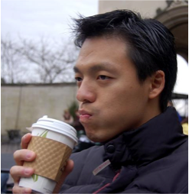
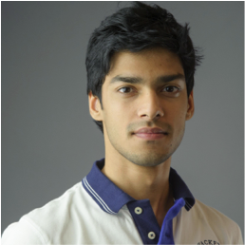
NecX Team
Chaoyu Yang
Shuowei Li
Keyu Chen
Aniket Handa

Slide 18
NecX Demo
Team2
http://horseshoe477.github.io/

